Slide 1
Lecture 1: Perceptron and Back Propagation

Slide 2
Outline
Description of the course
Introduction to Artificial Neural Networks
Review of Classification and Logistic Regression
Introduction to Optimization
Gradient Descent
Stochastic Gradient Descent
Back Propagation
Single Neuron Network (‘Perceptron’)
Multi-Layer Perceptron

Slide 3
Outline
Description of the course
Introduction to Artificial Neural Networks
Review of Classification and Logistic Regression
Introduction to Optimization
Gradient Descent
Stochastic Gradient Descent
Back Propagation
Single Neuron Network (‘Perceptron’)
Multi-Layer Perceptron

Slide 4
Schedule
Six Lectures @Fridays 8:00pm EST (Pavlos Protopapas):
Introduction
Design choices for NN, number of layers, number of nodes, activation function
Solver and Regularization
Convolutional Neural Networks, basic concepts and architectures
Convolutional Neural Networks part2 and state of the art networks
Auto-encoders
Six Labs @Saturdays 8:00pm EST (David Sondak)
Six Office hours @Mondays 8:00am EST (David Sondak)
Two assignments:
To be released Oct 23 midnight, due on Oct 30th midnight
To be released Nov 13 midnight, presentations on Nov 21st 8:00pm (EST)

Slide 5

Who
Pavlos Protopapas, Scientific Director of the Institute for Applied Computational Science (IACS). Teaches CS109a, CS109b and the Capstone course for the Data Science masters program. He is a leader in astrostatistics and he is excited about the new telescopes coming online in the next few years. He loves cooking and eating.

Slide 6
Who
David Sondak, computational mathematician and lecturer at the Institute for Applied Computational Science. He teaches CS207 and extreme computing. He loves maths and dogs!

Slide 7
Policies
We encourage you to talk and discuss the assignments with your fellow students (and on Piazza), but you are not allowed to look at any other students assignment or code outside of your group (max 3).
YOU CAN SUBMIT AS A GROUP.

Slide 8
Policies
Ethical behavior is an important trait of a Data Scientist, from ethically handling data to attribution of code and work of others. Thus, in this course we give a strong emphasis to Academic Honesty. As a student your best guidelines are to be reasonable and fair. We encourage teamwork for problem sets, but you should not split the homework and you should work on all the problems together. We have included some ideas below of acceptable and not acceptable​ behaviors. Engaging in not acceptable behavior regarding academic honesty will be handled harshly. Please be responsible and when in doubt ask either Pavlos or David.

Slide 9
Policies
ACCEPTABLE​:
➔ Discussing materials and engaging in OH.
➔ Helping debug.
➔ Using a few lines of code found online or other forum as long as you cite the origin and attribute authorship of code.
➔ Searching online to expand your knowledge and for debugging, but not for outright solutions to HWs.
➔ Using a tutor, provided the tutor does not do your work for you.

Slide 10
Policies
NOT ACCEPTABLE​:
➔ Accessing a solution to some problem prior to submitting your own.
➔ Failing to cite the origins of code or techniques that you discover outside of the course’s own lessons and integrate into your own work.
➔ Paying or offering to pay an individual for work that you may submit as your own.
➔ Providing or making available solutions to problem sets to individuals who might take this course in the future.
➔ Searching for or soliciting outright solutions to problem sets online or elsewhere.
➔ Splitting a problem set’s workload with another individual and combining your work.

Slide 11
Outline
Description of the course
Introduction to Artificial Neural Networks
Review of Classification and Logistic Regression
Introduction to Optimization
Gradient Descent
Stochastic Gradient Descent
Back Propagation
Single Neuron Network (‘Perceptron’)
Multi-Layer Perceptron

Slide 12
Watch this!
http://video.arstechnica.com/watch/sunspring-sci-fi-short-film

Slide 13
Artificial Neural Networks

Slide 14

Today’s news

Slide 15
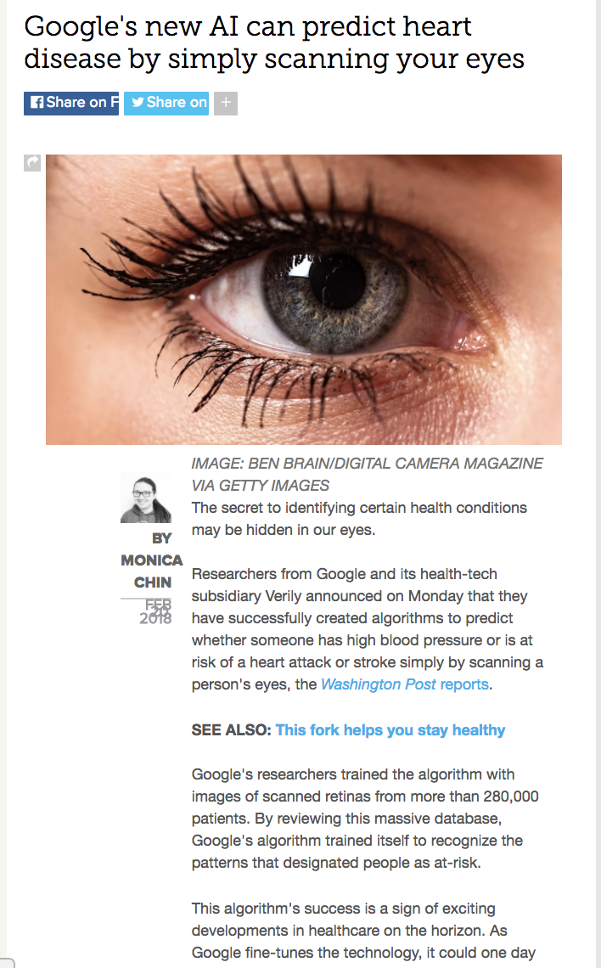
Today’s news

Slide 16
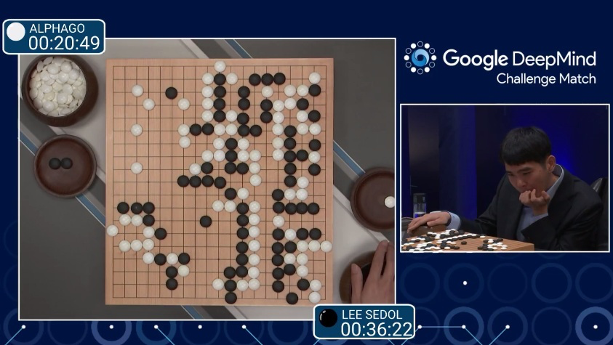
AlphaGo (2015)
First program to beat a professional Go player
Notes:
https://www.youtube.com/watch?v=PQCrX1sQSzY

Slide 17
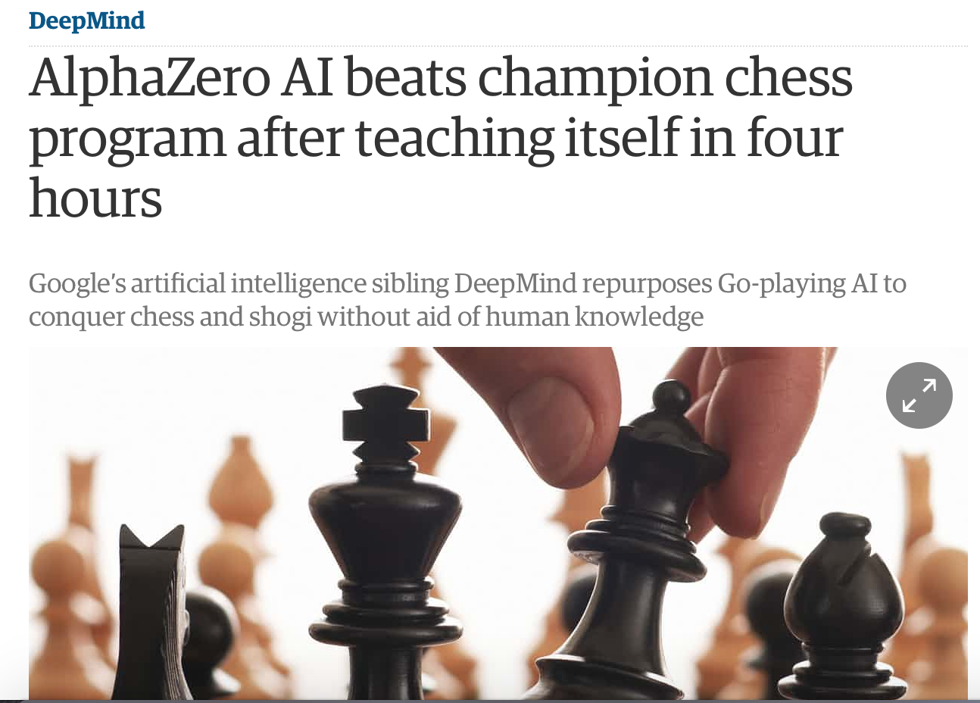
AlphaZero (2017)

Slide 18
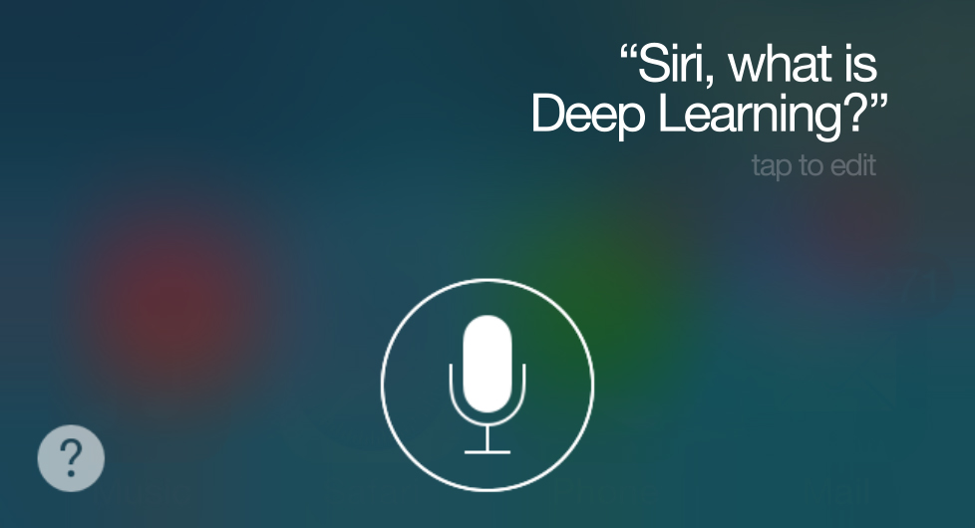
iOS Speech Synthesis (2016-)
Trained from 20 hours of high quality speech
machinelearning.apple.com
Notes:
https://machinelearning.apple.com/2017/08/06/siri-voices.html

Slide 19
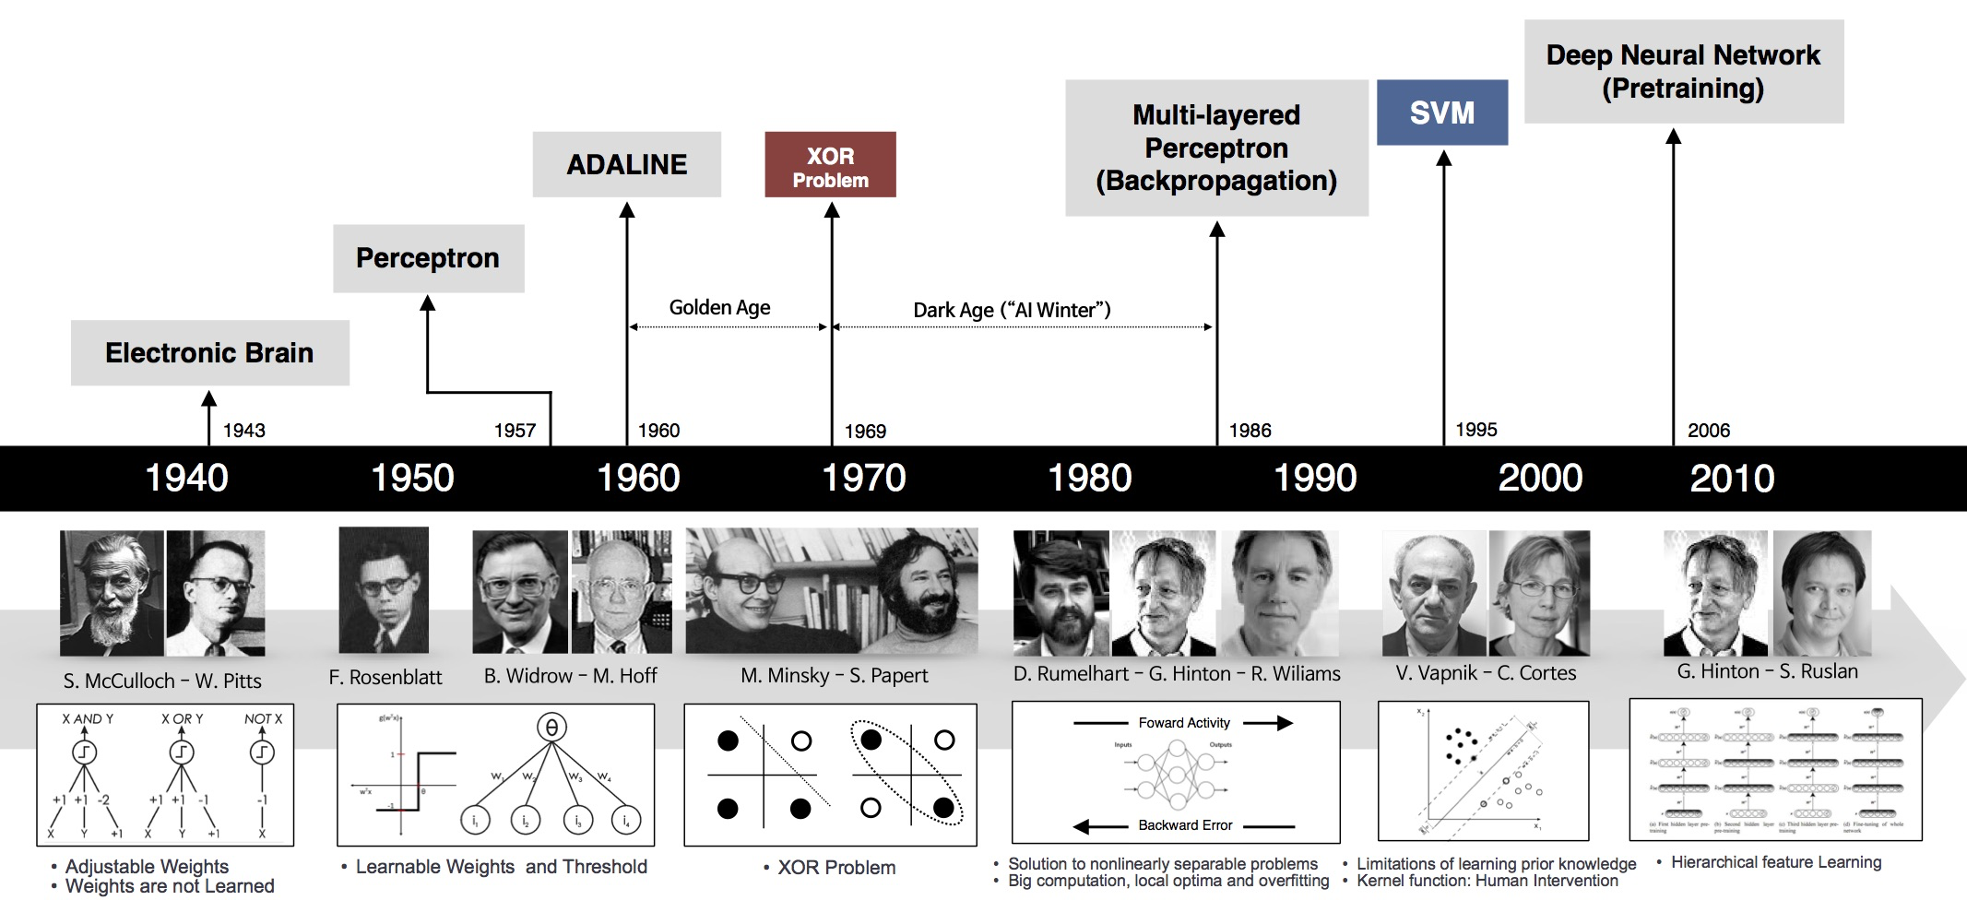
Historical Trends
beamandrew.github.io/

Slide 20
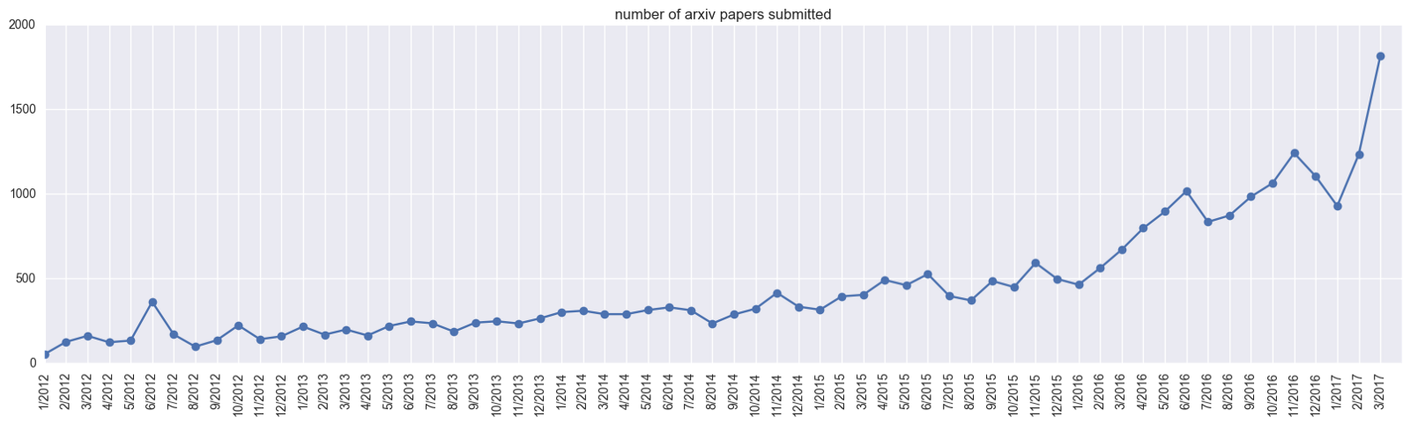
Historical Trends
ArXiv papers on deep learning: 2012-2017
ArXiv papers on deep learning: 2012-2017

Slide 21
Outline
Description of the course
Introduction to Artificial Neural Networks
Review of Machine Leaning. Classification and Logistic Regression
Introduction to Optimization
Gradient Descent
Stochastic Gradient Descent
Back Propagation
Single Neuron Network (‘Perceptron’)
Multi-Layer Perceptron

Slide 22
Machine Learning

Slide 23
Classification and Logistic Regression

Slide 24
Response vs. Predictor Variables
X
predictors
features
covariates
Y
outcome
response variable
dependent variable
TV | radio | newspaper | sales
230.1 | 37.8 | 69.2 | 22.1
44.5 | 39.3 | 45.1 | 10.4
17.2 | 45.9 | 69.3 | 9.3
151.5 | 41.3 | 58.5 | 18.5
180.8 | 10.8 | 58.4 | 12.9
n observations
p predictors

Slide 25
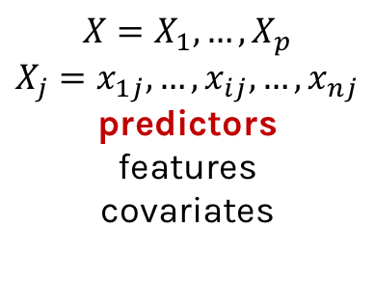
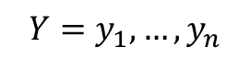
Response vs. Predictor Variables
$$X=X_{1},…,X_{p}$$
$$X_{j}=x_{1j},…,x_{ij},…,x_{nj}$$
predictors
features
covariates
outcome
response variable
dependent variable
$$Y=y_{1},…,y_{n}$$
TV | radio | newspaper | sales
230.1 | 37.8 | 69.2 | 22.1
44.5 | 39.3 | 45.1 | 10.4
17.2 | 45.9 | 69.3 | 9.3
151.5 | 41.3 | 58.5 | 18.5
180.8 | 10.8 | 58.4 | 12.9
n observations
p predictors

Slide 26
Heart Data
response variable Y
is Yes/No
Age | Sex | ChestPain | RestBP | Chol | Fbs | RestECG | MaxHR | ExAng | Oldpeak | Slope | Ca | Thal | AHD
63 | 1 | typical | 145 | 233 | 1 | 2 | 150 | 0 | 2.3 | 3 | 0.0 | fixed | No
67 | 1 | asymptomatic | 160 | 286 | 0 | 2 | 108 | 1 | 1.5 | 2 | 3.0 | normal | Yes
67 | 1 | asymptomatic | 120 | 229 | 0 | 2 | 129 | 1 | 2.6 | 2 | 2.0 | reversable | Yes
37 | 1 | nonanginal | 130 | 250 | 0 | 0 | 187 | 0 | 3.5 | 3 | 0.0 | normal | No
41 | 0 | nontypical | 130 | 204 | 0 | 2 | 172 | 0 | 1.4 | 1 | 0.0 | normal | No

Slide 27
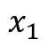
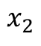
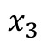
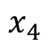
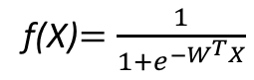
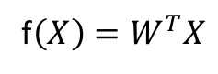
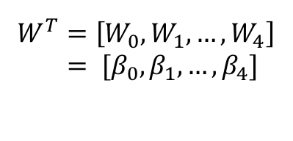
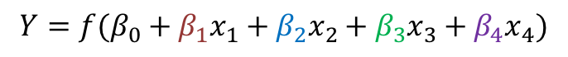
But what is the idea?
Start with Regression or Logistic Regression
Classification
Regression
f(X)$=\frac{1}{{1+e}^{−W^{T}X}}$
f$\left(X\right)=W^{T}X$
$$W^{T}=\left[W_{0},W_{1},…, W_{4}\right]$$
$= [β_{0}, β_{1},…, β_{4}]$
$$x_{1}$$
$$x_{2}$$
$$Y=f(β_{0}+β_{1}x_{1}+β_{2}x_{2}+β_{3}x_{3}+β_{4}x_{4})$$
$$x_{3}$$
$$x_{4}$$
Intercept or Bias
Coefficients or Weights

Slide 28
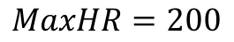
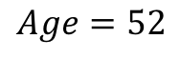
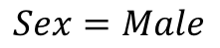
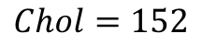
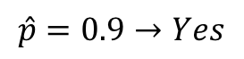
But what is the idea?
Start with all randomly selected weights. Most likely it will perform horribly.
For example, in our heart data, the model will be giving us the wrong answer.
$$MaxHR=200$$
Correct
$$Age=52$$
$$\hat{p}=0.9→Yes$$
y=No
$$Sex=Male$$
$$Chol=152$$
Bad Computer

Slide 29
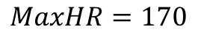
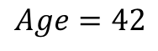
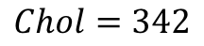
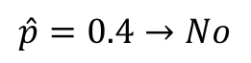
But what is the idea?
Start with all randomly selected weights. Most likely it will perform horribly.
For example, in our heart data, the model will be giving us the wrong answer.
$$MaxHR=170$$
Correct
$$Age=42$$
$$\hat{p}=0.4→No$$
y=Yes
$$Sex=Male$$
$$Chol=342$$
Bad Computer

Slide 30
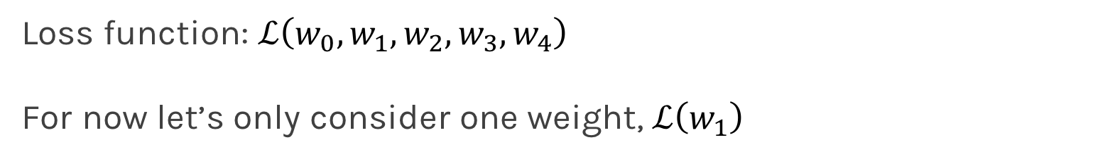
But what is the idea?
Loss Function: Takes all of these results and averages them and tells us how bad or good the computer or those weights are.
Telling the computer how bad or good is, does not help.
You want to tell it how to change those weights so it gets better.
Loss function: $ℒ\left(w_{0},w_{1},w_{2},w_{3},w_{4}\right)$
For now let’s only consider one weight, $ℒ\left(w_{1}\right)$

Slide 32
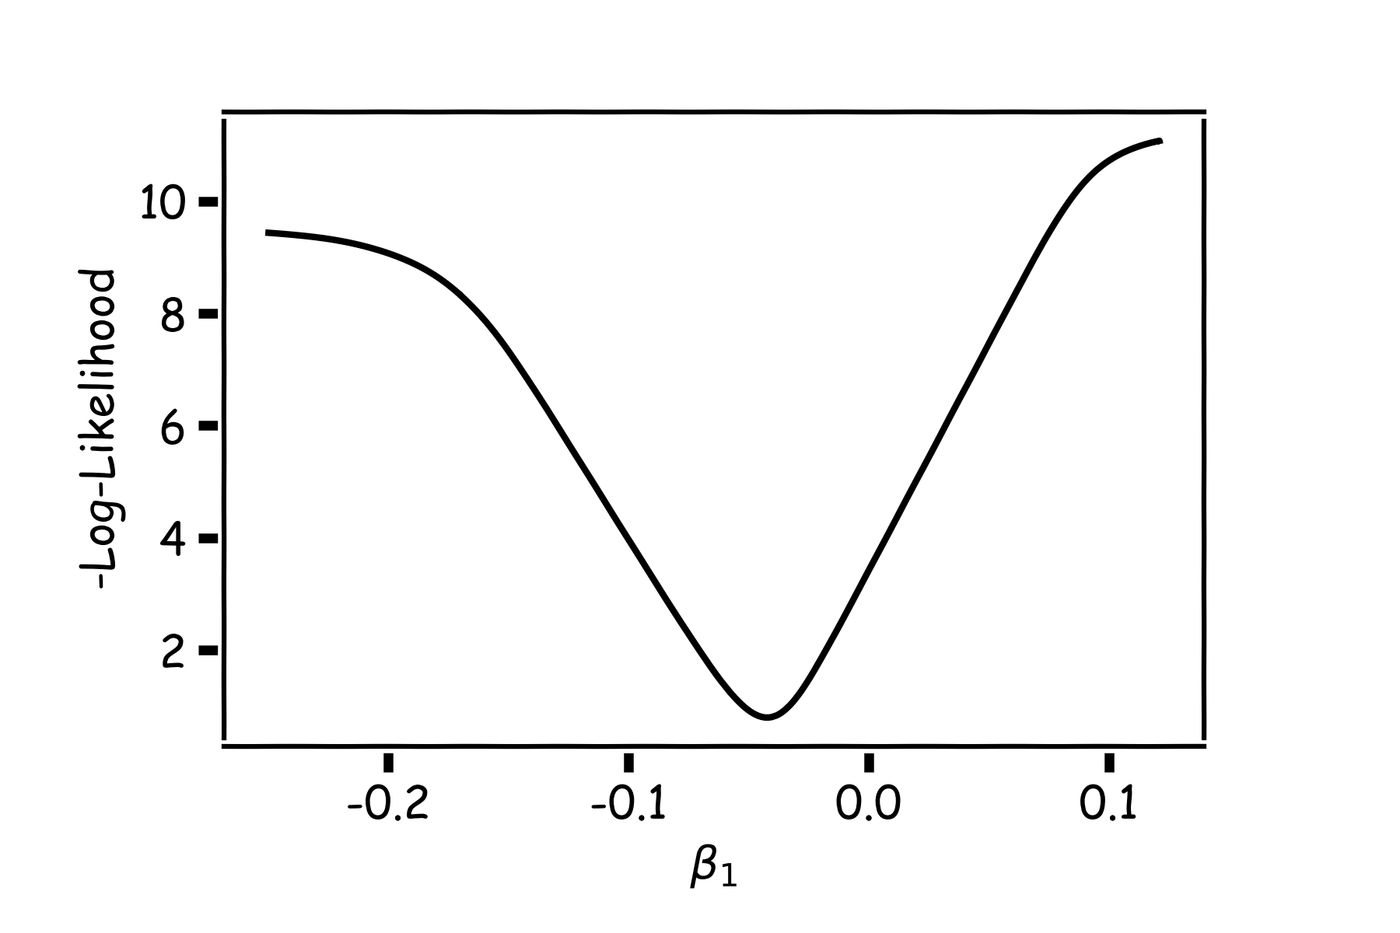
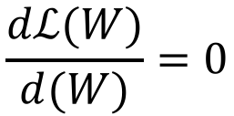
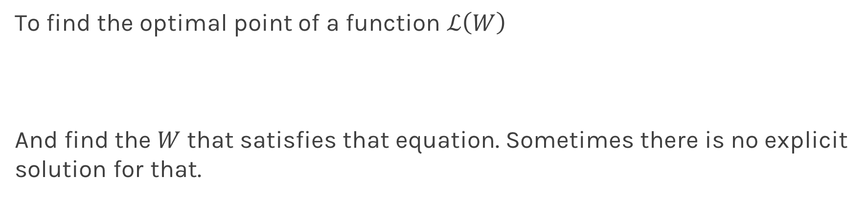
Minimizing the Loss function
Ideally we want to know the value of $w_{1}$ that gives the minimul $ℒ\left(W\right)$
To find the optimal point of a function $ℒ\left(W\right)$
And find the $W$ that satisfies that equation. Sometimes there is no explicit solution for that.
$$\frac{dℒ(W)}{d(W)}=0$$

Slide 33
Minimizing the Loss function
A more flexible method is
Start from any point
Determine which direction to go to reduce the loss direction (left or right)
Specifically if you can calculate the slope of the function at this point
Shift to the right if slope is negative or shift to the left if slope is positive
Repeat

Slide 34
Minimization of the Loss Function
If the step is proportional to the slope then you avoid overshooting the minimum.
Question: What is the mathematical function that describes the slope?
Question: How do we generalize this to more than one predictor?
Question: What do you think it is a good approach for telling the model how to change (what is the step size) to become better?

Slide 35
Minimization of the Loss Function
If the step is proportional to the slope then you avoid overshooting the minimum.
Question: What is the mathematical function that describes the slope? Derivative
Question: How do we generalize this to more than one predictor?
Take the derivative with respect to each coefficient and do the same sequentially
Question: What do you think it is a good approach for telling the model how to change (what is the step size) to become better?

Slide 36
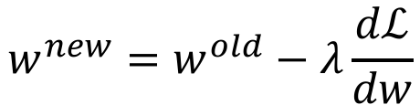
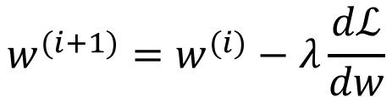
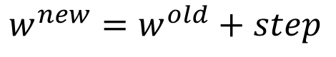
Let’s play the Pavlos game
We know that we want to go in the opposite direction of the derivative and we know we want to be making a step proportionally to the derivative.
Making a step means:
$${w^{new}=w}^{old}+step$$
Opposite direction of the derivative means:
$${w^{new}=w}^{old}−λ\frac{dℒ}{dw}$$
Learning Rate
Change to more conventional notation:
$${w^{(i+1)}=w}^{(i)}−λ\frac{dℒ}{dw}$$

Slide 37
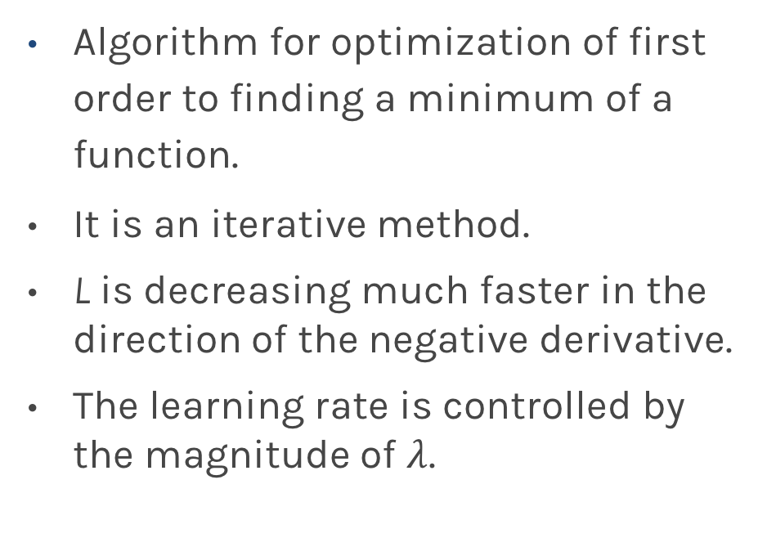
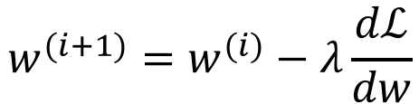
Gradient Descent
Algorithm for optimization of first order to finding a minimum of a function.
It is an iterative method.
L is decreasing much faster in the direction of the negative derivative.
The learning rate is controlled by the magnitude of $λ$.
$${w^{(i+1)}=w}^{(i)}−λ\frac{dℒ}{dw}$$
L
-
+
w

Slide 38
Considerations
We still need to calculate the derivatives.
We need to know what is the learning rates or how to set it.
Local vs global minima.
The full likelihood function includes summing up all individual ‘errors’. Unless you are a statistician, sometimes this includes hundreds of thousands of examples.

Slide 39
Derivatives: Memories from middle school

Slide 40
Linear Regression

Slide 41
Logistic Regression
Can you do it?
Wolfram Alpha can do it for us!
We need a formalism to deal with these derivatives.

Slide 42
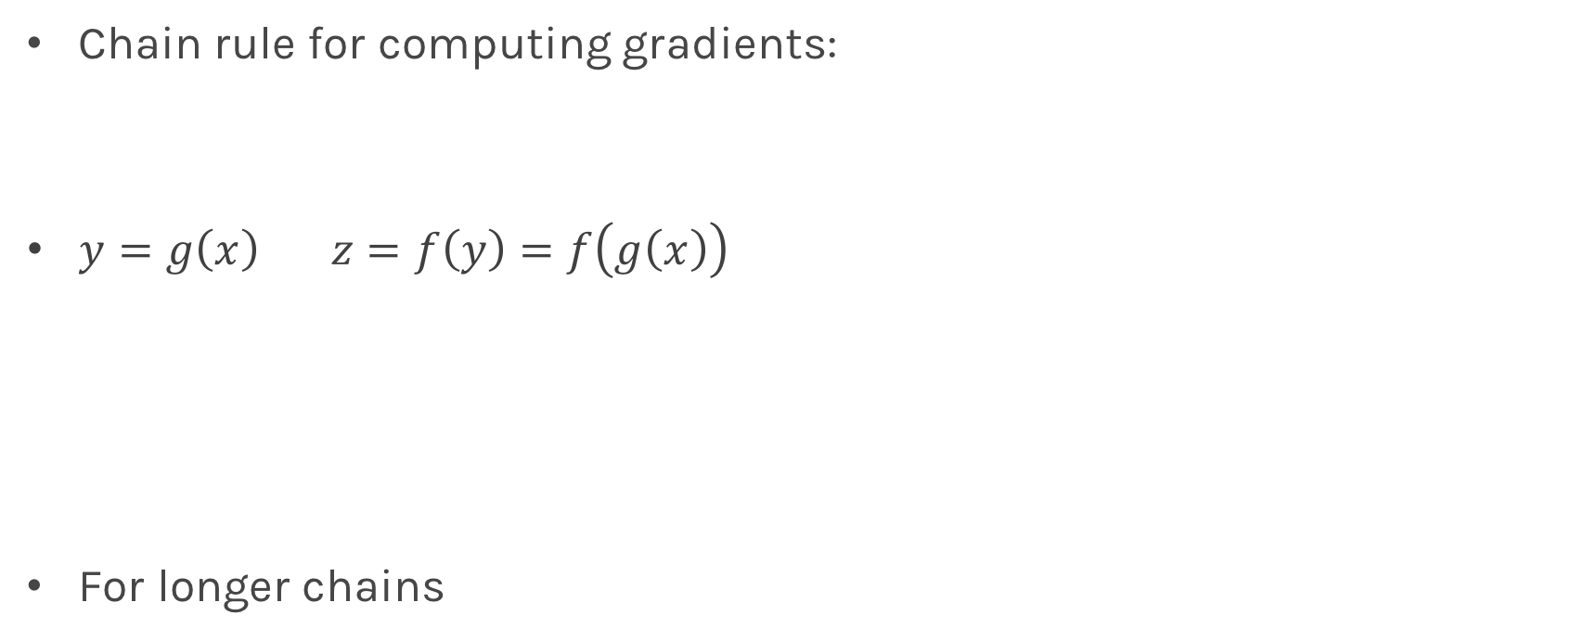
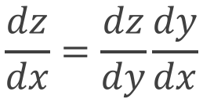
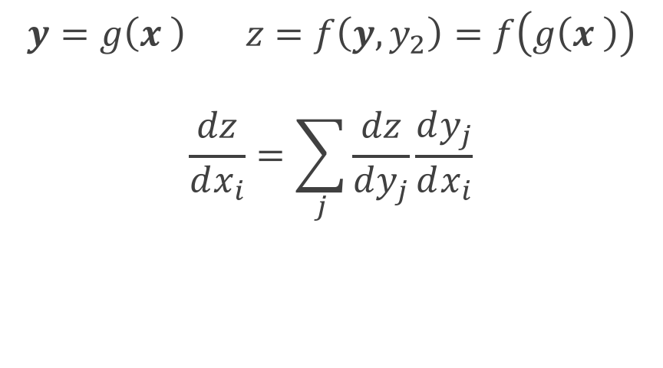
Chain Rule
Chain rule for computing gradients:
$y=g\left(x\right) z=f\left(y\right)=f\left(g\left(x\right)\right)$
For longer chains
$$y=g\left(x \right) z=f\left(y,y_{2}\right)=f\left(g\left(x \right)\right)$$
$$\frac{dz}{dx_{i}}=\sum_{j}{\frac{dz}{dy_{j}}\frac{dy_{j}}{dx_{i}}}$$
$$\frac{dz}{dx}=\frac{dz}{dy}\frac{dy}{dx}$$

Slide 43
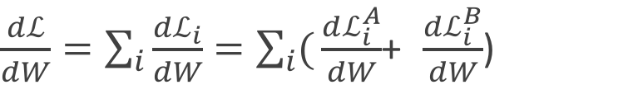
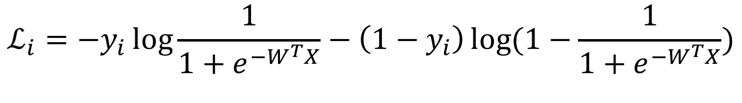
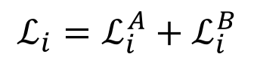
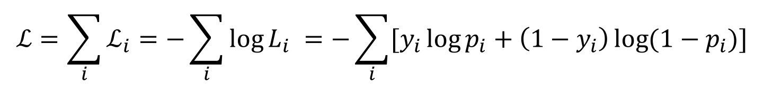
Logistic Regression derivatives
For logistic regression, the log of the loss function is:
$$ℒ=\sum_{i}{ℒ_{i}}=−\sum_{i}{\log{L_{i}}}{=−\sum_{i}{[y_{i}\log{p_{i}+\left(1−y_{i}\right)\log{(1−p_{i})]}}}}$$
$$ℒ_{i}={−y}_{i}\log{\frac{1}{1+e^{−W^{T}X}}−\left(1−y_{i}\right)\log{(1−\frac{1}{1+e^{−W^{T}X}})}}$$
To simplify the analysis let us split it into two parts,
$$ℒ_{i}=ℒ_{i}^{A}+ℒ_{i}^{B}$$
So the derivative with respect to W is:
$\frac{dℒ}{dW}=\sum_{i}{\frac{dℒ_{i}}{dW}}=\sum_{i}{(}\frac{dℒ_{i}^{A}}{dW}$+ $\frac{dℒ_{i}^{B}}{dW}$)

Slide 44
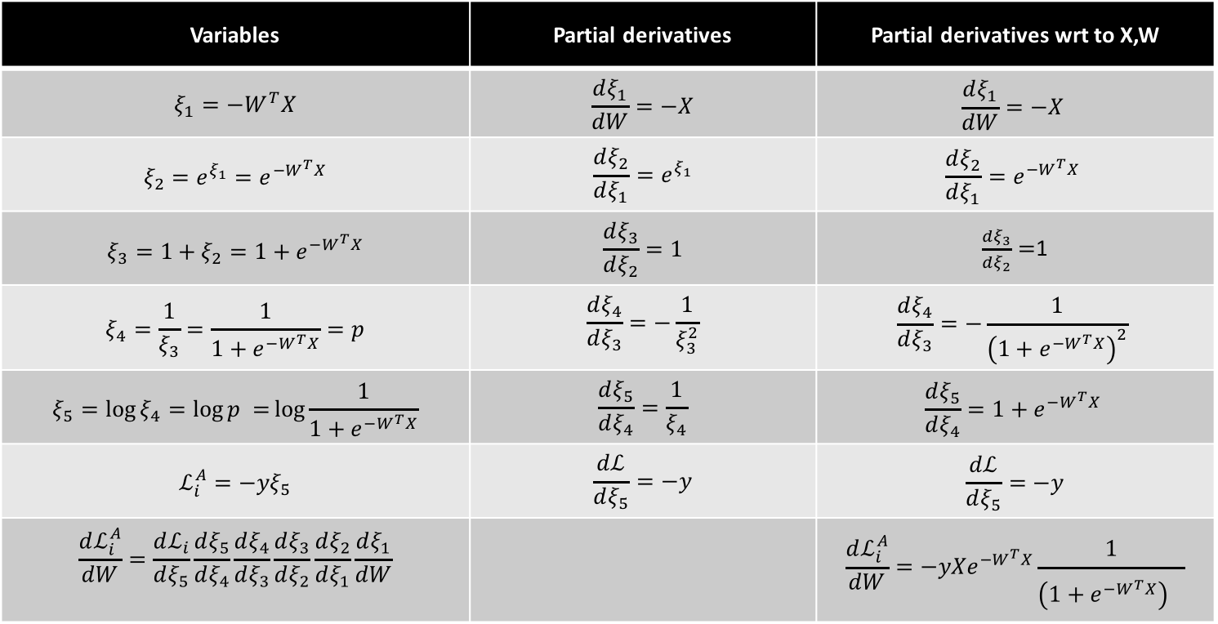
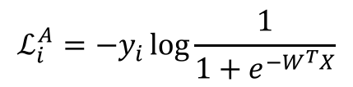
$$ℒ_{i}^{A}={−y}_{i}\log{\frac{1}{1+e^{−W^{T}X}}}$$
Variables | Partial derivatives | Partial derivatives wrt to X,W
$$ξ_{1}=−W^{T}X$$ | $$\frac{dξ_{1}}{dW}=−X$$ | $$\frac{dξ_{1}}{dW}=−X$$
$$ξ_{2}={e^{ξ_{1}}=e}^{−W^{T}X}$$ | $$\frac{dξ_{2}}{dξ_{1}}=e^{ξ_{1}}$$ | $$\frac{dξ_{2}}{dξ_{1}}=e^{−W^{T}X}$$
$$ξ_{3}=1+ξ_{2}=1+e^{−W^{T}X}$$ | $$\frac{dξ_{3}}{dξ_{2}}=1$$ | $\frac{dξ_{3}}{dξ_{2}}=$1
$$ξ_{4}=\frac{1}{ξ_{3}}=\frac{1}{1+e^{−W^{T}X}}=p$$ | $$\frac{dξ_{4}}{dξ_{3}}=−\frac{1}{ξ_{3}^{2}}$$ | $$\frac{dξ_{4}}{dξ_{3}}=−\frac{1}{{\left(1+e^{−W^{T}X}\right)}^{2}}$$
$$ξ_{5}=\log{ξ_{4}=\log{p =}\log{\frac{1}{1+e^{−W^{T}X}}}}$$ | $$\frac{dξ_{5}}{dξ_{4}}=\frac{1}{ξ_{4}}$$ | $$\frac{dξ_{5}}{dξ_{4}}=1+e^{−W^{T}X}$$
$$ℒ_{i}^{A}=−yξ_{5}$$ | $$\frac{dℒ}{dξ_{5}}=−y$$ | $$\frac{dℒ}{dξ_{5}}=−y$$
$$\frac{dℒ_{i}^{A}}{dW}=\frac{dℒ_{i}}{dξ_{5}}\frac{dξ_{5}}{dξ_{4}}\frac{dξ_{4}}{dξ_{3}}\frac{dξ_{3}}{dξ_{2}}\frac{dξ_{2}}{dξ_{1}}\frac{dξ_{1}}{dW}$$ |  | $${\frac{dℒ_{i}^{A}}{dW}=−yXe}^{−W^{T}X}\frac{1}{{\left(1+e^{−W^{T}X}\right)}^{}}$$

Slide 45
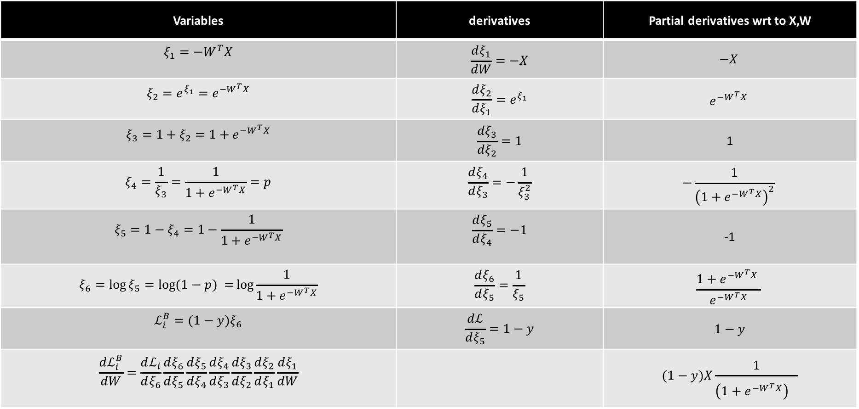
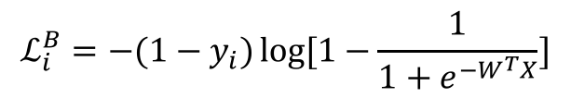
$$ℒ_{i}^{B}={−(1−y}_{i})\log{[1−\frac{1}{1+e^{−W^{T}X}}]}$$
Variables | derivatives | Partial derivatives wrt to X,W
$$ξ_{1}=−W^{T}X$$ | $$\frac{dξ_{1}}{dW}=−X$$ | $$−X$$
$$ξ_{2}={e^{ξ_{1}}=e}^{−W^{T}X}$$ | $$\frac{dξ_{2}}{dξ_{1}}=e^{ξ_{1}}$$ | $$e^{−W^{T}X}$$
$$ξ_{3}=1+ξ_{2}=1+e^{−W^{T}X}$$ | $$\frac{dξ_{3}}{dξ_{2}}=1$$ | 1
$$ξ_{4}=\frac{1}{ξ_{3}}=\frac{1}{1+e^{−W^{T}X}}=p$$ | $$\frac{dξ_{4}}{dξ_{3}}=−\frac{1}{ξ_{3}^{2}}$$ | $$−\frac{1}{{\left(1+e^{−W^{T}X}\right)}^{2}}$$
$$ξ_{5}=1−ξ_{4}=1−\frac{1}{1+e^{−W^{T}X}}$$ | $$\frac{dξ_{5}}{dξ_{4}}=−1$$ | -1
$$ξ_{6}=\log{ξ_{5}=\log{(1−p) =}\log{\frac{1}{1+e^{−W^{T}X}}}}$$ | $$\frac{dξ_{6}}{dξ_{5}}=\frac{1}{ξ_{5}}$$ | $$\frac{1+e^{−W^{T}X} }{e^{−W^{T}X}}$$
$$ℒ_{i}^{B}=(1−y)ξ_{6}$$ | $$\frac{dℒ}{dξ_{5}}=1−y$$ | $$1−y$$
$$\frac{dℒ_{i}^{B}}{dW}=\frac{dℒ_{i}}{dξ_{6}}\frac{dξ_{6}}{dξ_{5}}\frac{dξ_{5}}{dξ_{4}}\frac{dξ_{4}}{dξ_{3}}\frac{dξ_{3}}{dξ_{2}}\frac{dξ_{2}}{dξ_{1}}\frac{dξ_{1}}{dW}$$ |  | $$(1−y)X\frac{1}{{\left(1+e^{−W^{T}X}\right)}^{}}$$

Slide 47
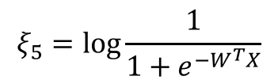
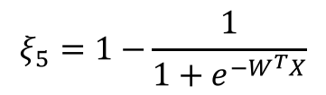
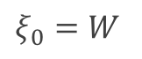

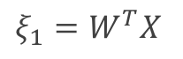
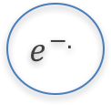





$$ξ_{5}=log{\frac{1}{1+e^{−W^{T}X}}}$$
$$ξ_{4}={1/(1+e}^{−W^{T}X})$$
$$÷$$
Log
$$ξ_{3}={1+e}^{−W^{T}X}$$
$$+$$
log
-
1
$$ξ_{5}=1−{\frac{1}{1+e^{−W^{T}X}}}$$
$$e^{−.}$$
$$ξ_{2}=e^{−W^{T}X}$$
$$ξ_{1}=W^{T}X$$
$$×$$
W
X
$$ξ_{0}=W$$

Slide 48

Evaluation of derivatives (forward mode)
Make sure everything is complete with the sum and we can evaluate the derivatives
Say we want to evaluate the derivative wrt W at some X and current W. We have a pretty good prescription
Things break if we have more than one layer and we want to evaluate the derivative with respect to
The model we have will not work. We will return to this later
$$W^{(i+1)}=W^{(i)}−λ\frac{dℒ}{dW}{\left.​\right|}_{W^{i}}$$

Slide 49

Evaluation of derivatives (forward mode) ex. X={1,2,3}, Y={2,3,4)
Variables | derivatives
$$ξ_{1}=−W^{T}X$$ | $$\frac{dξ_{1}}{dW}=−X$$ | $$−X$$
$$ξ_{2}={e^{ξ_{1}}=e}^{−W^{T}X}$$ | $$\frac{dξ_{2}}{dξ_{1}}=e^{ξ_{1}}$$ | $$e^{−W^{T}X}$$
$$ξ_{3}=1+ξ_{2}=1+e^{−W^{T}X}$$ | $$\frac{dξ_{3}}{dξ_{2}}=1$$ | 1
$$ξ_{4}=\frac{1}{ξ_{3}}=\frac{1}{1+e^{−W^{T}X}}=p$$ | $$\frac{dξ_{4}}{dξ_{3}}=−\frac{1}{ξ_{3}^{2}}$$ | $$−\frac{1}{{\left(1+e^{−W^{T}X}\right)}^{2}}$$
$$ξ_{5}=\log{ξ_{4}=\log{p =}\log{\frac{1}{1+e^{−W^{T}X}}}}$$ | $$\frac{dξ_{5}}{dξ_{4}}=\frac{1}{ξ_{4}}$$ | $$1+e^{−W^{T}X}$$
$$ℒ_{i}^{A}=−yξ_{5}$$ | $$\frac{dℒ}{dξ_{5}}=−y$$ | $$−y$$
$$\frac{dℒ_{i}^{A}}{dW}=\frac{dℒ_{i}}{dξ_{5}}\frac{dξ_{5}}{dξ_{4}}\frac{dξ_{4}}{dξ_{3}}\frac{dξ_{3}}{dξ_{2}}\frac{dξ_{2}}{dξ_{1}}\frac{dξ_{1}}{dW}$$ |  | $${−yXe}^{−W^{T}X}\frac{1}{{\left(1+e^{−W^{T}X}\right)}^{}}$$

Slide 50
Learning Rate

Slide 51

Learning Rate
Trial and Error.
There are many alternative methods which address how to set or adjust the learning rate, using the derivative or second derivatives and or the momentum. To be discussed in the next lectures.
J. Nocedal y S. Wright, “Numerical optimization”, Springer, 1999 🔗
TLDR: J. Bullinaria, “Learning with Momentum, Conjugate Gradient Learning”, 2015 🔗

Slide 52
Local and Global minima

Slide 53
Local vs Global Minima
L
𝛉

Slide 54
Local vs Global Minima
L
𝛉

Slide 55
Local vs Global Minima
No guarantee that we get the global minimum.
Question: What would be a good strategy?

Slide 56
Large data

Slide 57


Batch and Stochastic Gradient Descent
$$ℒ=−\sum_{i}{[y_{i}\log{p_{i}+\left(1−y_{i}\right)\log{(1−p_{i})]}}}$$
Instead of using all the examples for every step, use a subset of them (batch).
For each iteration k, use the following loss function to derive the derivatives:
which is an approximation to the full Loss function.
$$ℒ^{k}=−\sum_{i∈b^{k}}{[y_{i}\log{p_{i}+\left(1−y_{i}\right)\log{(1−p_{i})]}}}$$

Slide 58
Batch and Stochastic Gradient Descent
Full Likelihood:
L
Batch Likelihood:
𝛉

Slide 59
Batch and Stochastic Gradient Descent
Full Likelihood:
L
Batch Likelihood:
𝛉

Slide 60
Batch and Stochastic Gradient Descent
Full Likelihood:
L
Batch Likelihood:
𝛉

Slide 61
Batch and Stochastic Gradient Descent
Full Likelihood:
L
Batch Likelihood:
𝛉

Slide 62
Batch and Stochastic Gradient Descent
Full Likelihood:
L
Batch Likelihood:
𝛉

Slide 63
Batch and Stochastic Gradient Descent
Full Likelihood:
L
Batch Likelihood:
𝛉

Slide 64
Batch and Stochastic Gradient Descent
Full Likelihood:
L
Batch Likelihood:
𝛉

Slide 65
Batch and Stochastic Gradient Descent
Full Likelihood:
L
Batch Likelihood:
𝛉

Slide 66
Batch and Stochastic Gradient Descent
Full Likelihood:
L
Batch Likelihood:
𝛉

Slide 67
Backpropagation

Slide 68












Backpropagation: Logistic Regression Revisited
Affine
Activation
Loss Fun
$$p_{i}=\frac{1}{1+e^{−h_{i}}}$$
$$x_{i}$$
$$h_{i}=β_{0}+β_{1}x_{i}$$
$$ℒ_{i}\left(β\right)=−y_{i}\ln\left(p_{i}\right)−\left(1−y_{i}\right)ln⁡(1−p_{i})$$
Affine
Activation
Loss Fun
$$p_{i}=\frac{1}{1+e^{−h_{k}}}$$
$$x_{k}$$
$$h_{k}=β_{0}+β_{1}x_{k}$$
$$ℒ_{k}\left(β\right)=−y_{k}\ln\left(p_{k}\right)−\left(1−y_{k}\right)ln⁡(1−p_{k})$$
…
Affine
Activation
Loss Fun
$$ℒ(β)=\sum_{i}^{n}{ℒ_{i}\left(β\right)}$$
$$p=\frac{1}{1+e^{−h}}$$
$$X$$
$$h=β_{0}+β_{1}X$$

Slide 69






Backpropagation: Logistic Regression Revisited
Affine
Activation
Loss Fun
$$ℒ(β)=\sum_{i}^{n}{ℒ_{i}\left(β\right)}$$
$$p=\frac{1}{1+e^{−h}}$$
$$X$$
$$h=β_{0}+β_{1}X$$
$\frac{∂ℒ}{∂p}$ $\frac{∂p}{∂h}$ $\frac{∂h}{∂β}$
$\frac{∂ℒ}{∂p}$ $\frac{∂p}{∂h}$
$$\frac{∂ℒ}{∂p}$$

Slide 70








Build our first ANN
Affine
Activation
Loss Fun
$$ℒ(β)=\sum_{i}^{n}{ℒ_{i}\left(β\right)}$$
$$p=\frac{1}{1+e^{−h}}$$
$$X$$
$$h=β_{0}+β_{1}X$$
Affine
Activation
Loss Fun
$$ℒ(β)=\sum_{i}^{n}{ℒ_{i}\left(β\right)}$$
$$p=\frac{1}{1+e^{−h}}$$
$$X$$
$$h=Xβ$$
Affine
Activation
Loss Fun
$$ℒ(W)=\sum_{i}^{n}{ℒ_{i}\left(W\right)}$$
$$y=\frac{1}{1+e^{−h}}$$
$$X$$
$$h=XW$$

Slide 71





Build our first ANN
Affine
Activation
Loss Fun
$$ℒ(W)=\sum_{i}^{n}{ℒ_{i}\left(W\right)}$$
$$p=\frac{1}{1+e^{−h}}$$
$$X$$
$$h=XW$$
$$X$$
$$Y$$
Single Neuron Network
Very similar to Perceptron

Slide 72

Example Using Heart Data
Slightly modified data to illustrate concepts.

Slide 73



Example Using Heart Data
$$X$$
$$Y$$

Slide 74






Example
$$X$$
$$Y$$
$$X$$
$Y$’

Slide 75








Pavlos game #232
W₁
W₁
$$X$$
$$Y$$
$$h_{1}$$
$$h_{1}+h_{2}$$
$$X$$
W₂
W₂
$$h_{2}$$
$$X$$
$$Y′$$

Slide 76


Pavlos game #232
$$q= W_{31}h_{1}+{W_{32}h}_{2}+W_{30}$$
$$p=\frac{1}{1+e^{−q}}$$
W₁
W₁
$$X$$
$$Y$$
$$h_{1}$$
$$W_{3}$$
$$X$$
W₂
W₂
$$h_{2}$$
$$X$$
$$Y$$

Slide 77


Pavlos game #232
$$q= W_{31}h_{1}+{W_{32}h}_{2}+W_{\begin{aligned}30 \\ \end{aligned}}$$
$$p=\frac{1}{1+e^{−q}}$$
W₁
W₁
$$X$$
$$Y$$
$$h_{1}$$
$$W_{3}$$
$$X$$
W₂
W₂
$$h_{2}$$
$$X$$
$$Y$$
$$L=y ln\left(p\right)+\left(1−y\right)ln(1−p)$$

Slide 78
Pavlos game #232
$$q= W_{31}h_{1}+{W_{32}h}_{2}+W_{\begin{aligned}30 \\ \end{aligned}}$$
$$p=\frac{1}{1+e^{−q}}$$
W₁
W₁
$$X$$
$$Y$$
$$h_{1}$$
$$W_{3}$$
$$X$$
W₂
W₂
$$h_{2}$$
$$X$$
$$Y$$
Need to update W1, W2 and W3.
$$L=y ln\left(p\right)+\left(1−y\right)ln(1−p)$$

Slide 79
Artificial Neural Networks
Machine Learning Algorithm
Very simplified parametric models of our brain
Networks of basic processing units: neurons
Neurons store information which has to be learned
Many types of architectures to solve different tasks
They can scale to massive data
They can train in parallel
...
...
...
...
...
99.9%
dog

